Slide 1
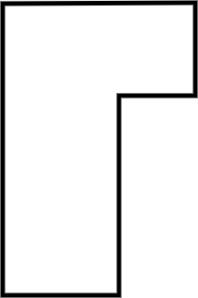
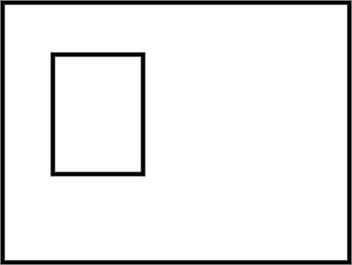
Calculating missing side lengths from the area of composite rectilinear shapes
Task A: Calculating area with missing side lengths
1) Calculate the area of each composite rectilinear shape.
a) b)
16 m
12 m
3 m
17 m
2 m
9 m
11 m
6 m
4 m
5 m
5 m
11 m
19 m
Area = 16 × 12 - 11 × 4
Area = 192 - 44
Area = 148 m²
Area = 17 × 19 - 9 × 6
Area = 323 - 54
Area = 269 m²

Slide 2
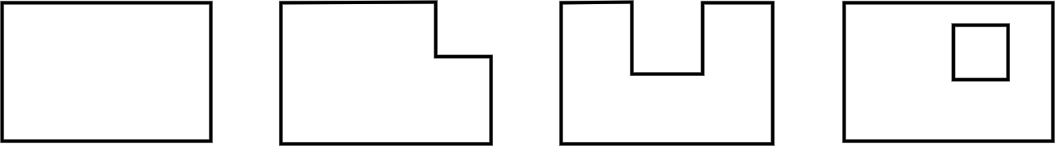
Calculating missing side lengths from the area of composite rectilinear shapes
Task B: Finding a missing side length using area
1) Calculate the length of the marked side.
a) b)
23 cm
18 cm
13 cm
4 cm
2 cm
7 cm
h
Area = 309 cm²
t
309 = 23 × 11 + 7h
309 = 253 + 7h
56 = 7h
8 = h
The marked side is 8 cm long.
Area = 187 cm²
187 = 13t − 4 × 2
187 = 13t − 8
195 = 13t
15 = t
The marked side is 15 cm long.
Task C: Working with perimeter and area
1) Which shapes have the same area? Which have the same perimeter?
a) b) c) d)
3 mm
3 mm
3 mm
8 mm
3 mm
3 mm
3 mm
8 mm
8 mm
8 mm
10 mm
10 mm
10 mm
10 mm
Shape A has an area of 80 mm². Shapes B, C and D all have the same area of 71 mm².
Shapes A and B both have a perimeter of 36 mm. Shape C has a perimeter of 42 mm.
Shape D is ambiguous - do you want to include the square or not?
Mathematics in Education and Industry.

